Slide 1

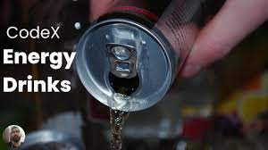



UNLOCKING MARKETING POTENTIAL IN THE FOOD & BEVERAGE INDUSTRY
DHARMANA LEELAMBARA DATTA

Slide 2

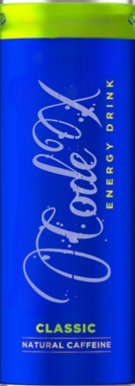
CONTENT
01
ABOUT CODEX BEVERAGE COMPANY
02
GOALS AND OBJECTIVES
03
STAGES IN THE PROJECT
04
PRIMARY RESEARCH
05
SECONDARY RESEARCH
06
RECOMMENDATIONS

Slide 3

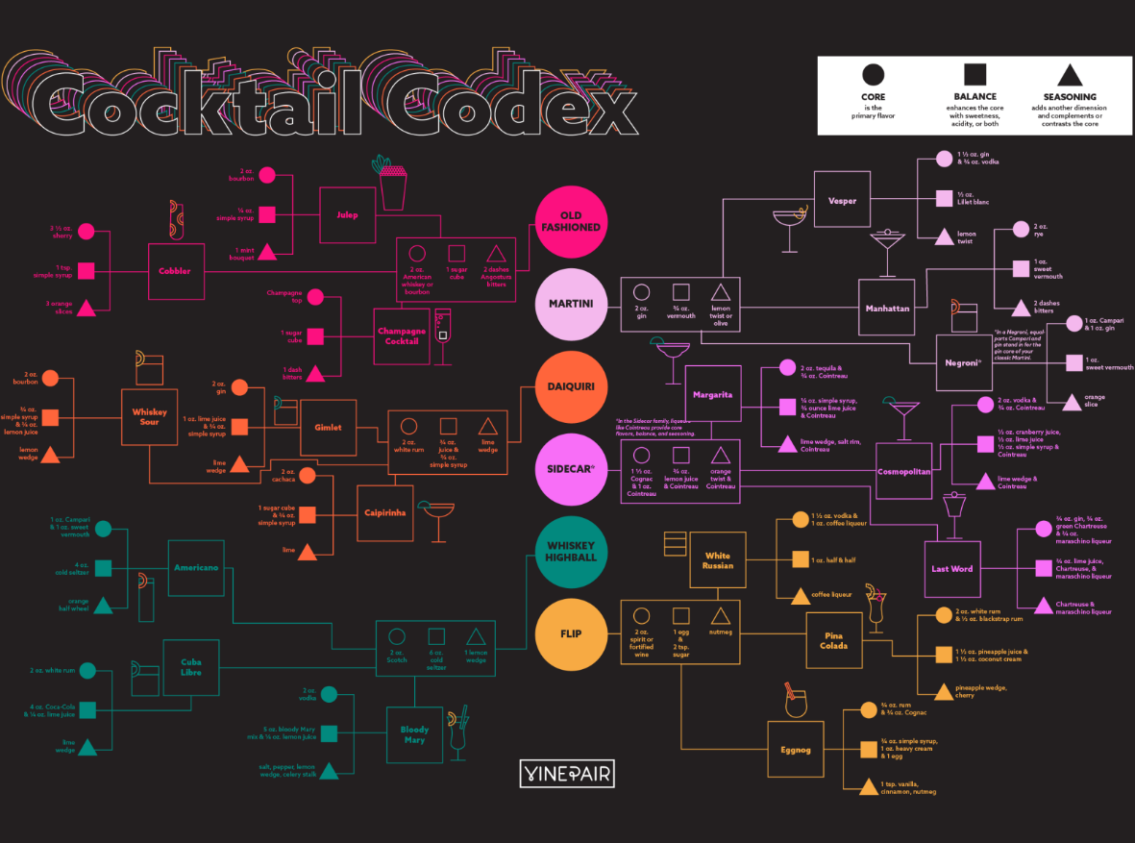
ABOUT CODEX
Code X is a German beverage company that is aiming to make its mark in the Indian market. A few months ago, they had launched their energy drink in 10 cities in India.
Code X is a relatively new company or a smaller local brand that hasn't gained widespread recognition yet. Alternatively, it's also possible that the company is not well-known outside of Germany or it operates under a different name or spelling.
.
As a Data Analyst enthusiastic I should act solely responsible for increasing brand awareness, market share, and product development for the Codex Company.
The Codex team has conducted a survey in the 10 cities and received results from 10k respondents.
Now as a Challengers we should act as a marketing data analyst were assigned a task to convert these survey results to meaningful insights which the team can use to drive actions.

Slide 4






GOALS AND OBJECTIVES
`OBJECTIVE n ° 1
`OBJECTIVE n ° 2
`OBJECTIVE n ° 3
The main primary objective is to generate the primary insights based on the survey responses. Our main motto is to generate a good number of appealing information for further development
Taking into consideration a furthermore advancement is needed in the field of additional market research. Which is the key influencing agent of business for its growth.
To support codex beverage company so as to expand its business in India as a better brand amoung the existing competitors by providing various informative data driven decisions

Slide 5

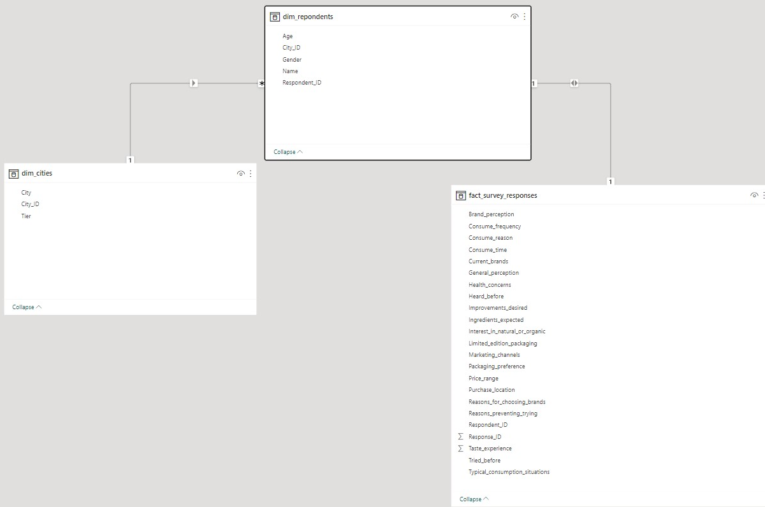
SCHEMATIC VIEW OF DATA (DATA MODELLING)

Slide 6
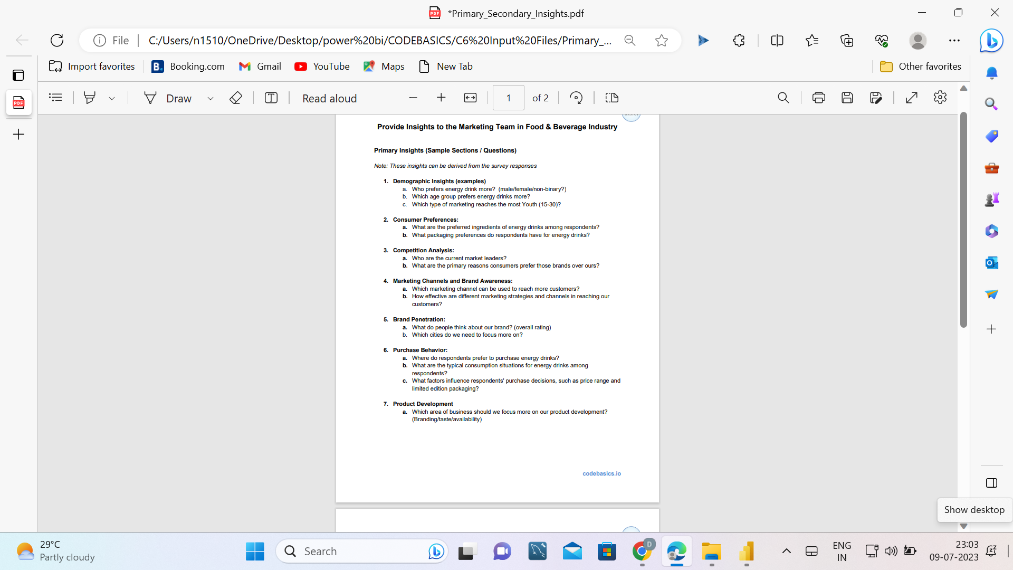
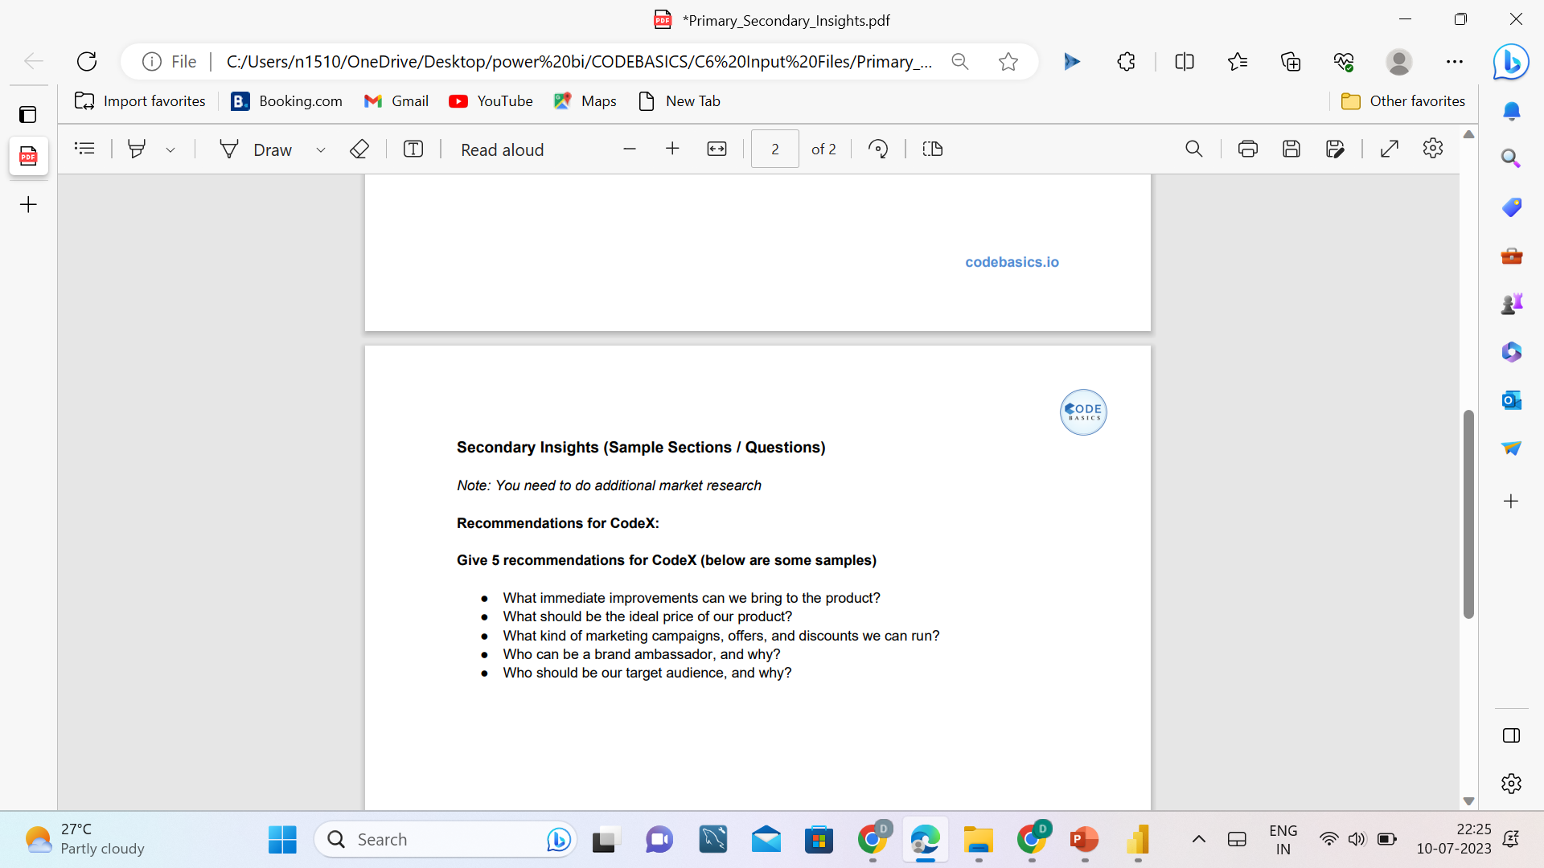
STAGES IN THE PROJECT
Preliminary Research
Secondary research
Recommendations

Slide 7
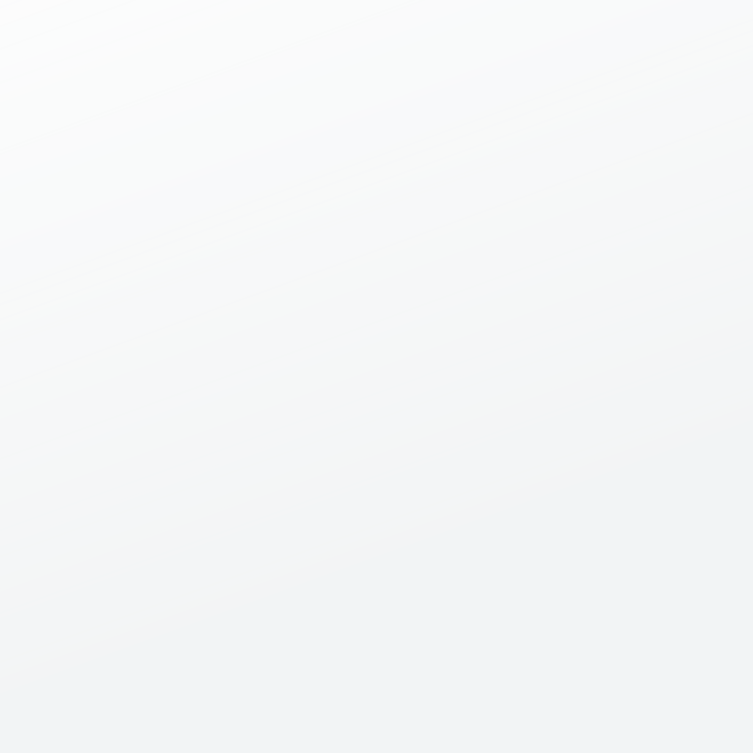
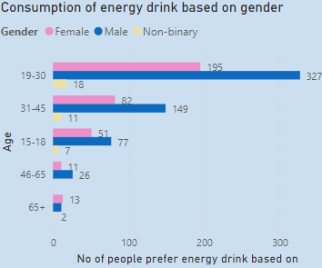
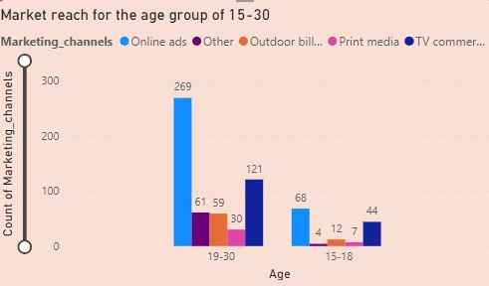
PRIMARY INSIGHTS BASED ON SURVEY RESPONSES
PREFERENCE OF ENERGY DRINK BASED ON GENDER AND AGE GROUP
Based on gender Our codex energy drink is prefered mostly by Male
Among all the various age group persons preference keeping aside it is consumed by male persons at an age group of 19-30.
TYPE OF MARKETING REACHES THE MOST YOUTH (15-30)?
Marketing channels reaching the youth comprising an Age range of 15-30 are firstly
Online Ads
Tv Commercial ads

Slide 8
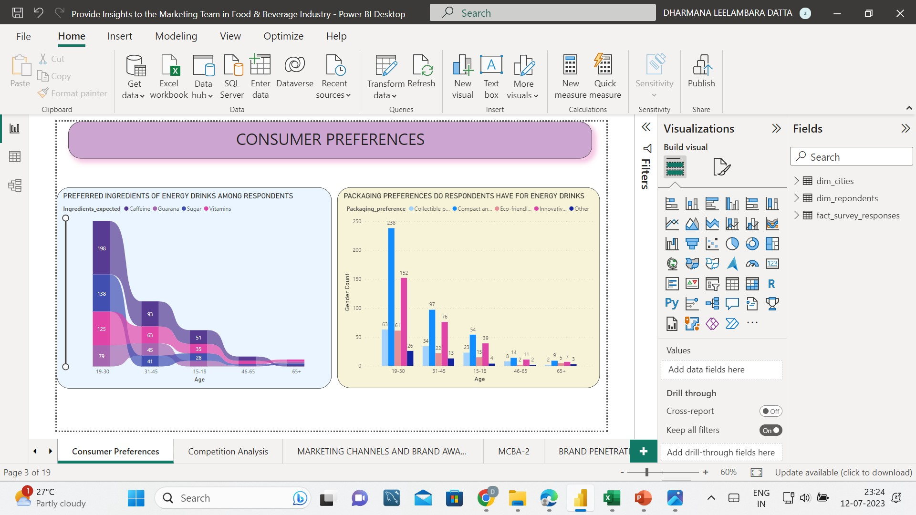
PRIMARY INSIGHTS BASED ON SURVEY RESPONSES
PREFERRED INGREDIENTS OF ENERGY DRINKS AMONG RESPONDENTS
The most preferred ingredients among the respondents is Caffeine for every age group except 65+ age group
Second most ingredient preferred is Sugar for the age group of 19-30 at a which majority people reside and it changes for the other age groups
Third most preferred ingredient is Vitamins for 19-30 and is second most preferred ingredient for remaining age group
Overall this visual portrays that as the age increases the consciousness on health increasing
PACKAGING PREFERENCES DO RESPONDENTS HAVE FOR ENERGY DRINKS
From all the responses based on different age groups all have followed a particular order but majority of the responses are from 19-30 age group.
The packaging preferences are as follows in order
1.Compact and portable cans
2 Innovative bottle design
3Collectible packaging
4Ecofriendly design
5Others

Slide 9
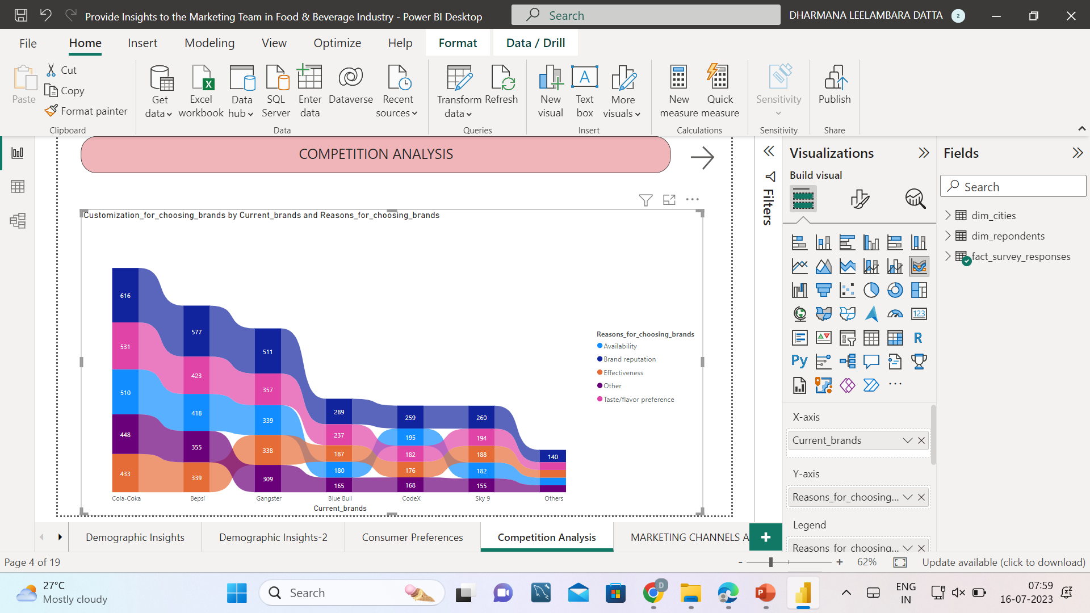
PRIMARY INSIGHTS BASED ON SURVEY RESPONSES
CURRENT MARKET LEADERS AND THE PRIMARY REASONS CONSUMERS PREFER THOSE BRANDS OVER OURS
The current market leader are based on the ranking as follows
1.Cola coka
2. Bepsi
3.Gangster
4.Blue bull
5.Codex
6.Sky9
7.Others
Reasons why people purchase those brands Brand Reputation at a higher rate next taste/ flavor experience,Availability are the three key main reasons that make them a top competing and leading ones in the market
Our codec brand Reasons for choosing as follows firstly Brand Reputation next Availability, taste/ flavour experience.

Slide 10
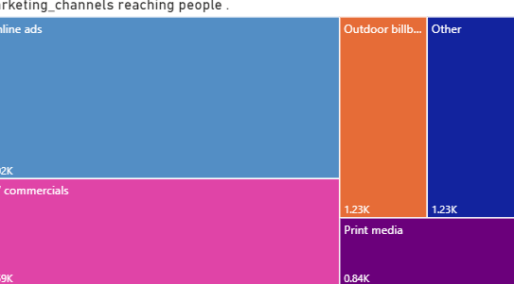
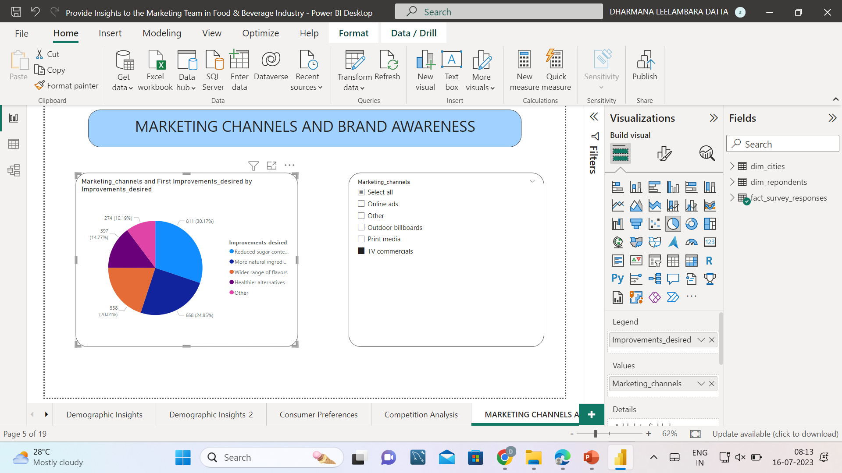
PRIMARY INSIGHTS BASED ON SURVEY RESPONSES
MARKETING CHANNEL USED TO REACH MORE CUSTOMERS
Marketing channel that is used to reach the customers are depicted in a tree map
Where majority of area is occupied by Online ads ,next Tv Commercials ,Outdoor buildings , others, Print media
EFFECTIVENESS OF DIFFERENT MARKETING STRATEGIES AND CHANNELS IN REACHING OUR CUSTOMERS
Strategies where one brand can promote through marketing channels using this particular changes in order
a)Reduced sugar content
b)More natural ingredients
c) Wider range of flavors
d)Healthier alternatives
e) Others

Slide 11
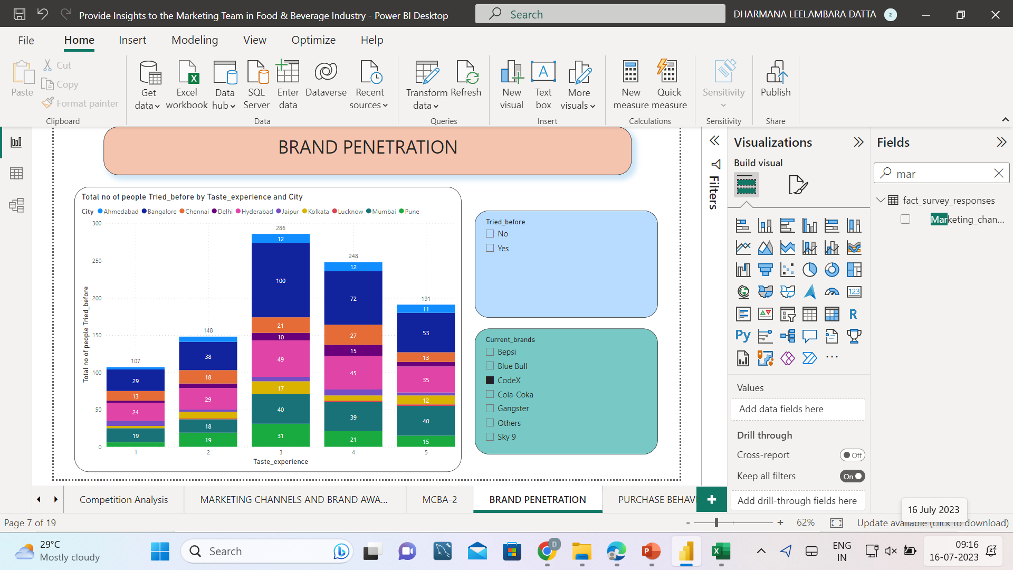
PRIMARY INSIGHTS BASED ON SURVEY RESPONSES
OVERALL RATING OF OUR BRAND
Overall rating of our brand based on taste experience is 3(Average) with a number of 286.and later 4(Good)with a number of 248,and 5 (excellent)with a number of 191
CITIES DO WE NEED TO FOCUS MORE ON
Bangalore, Hyderabad, Pune are the top three cities where our rating is good and people are purchasing there only hence in order to expand our business we should mainly focus on these cities.

Slide 12
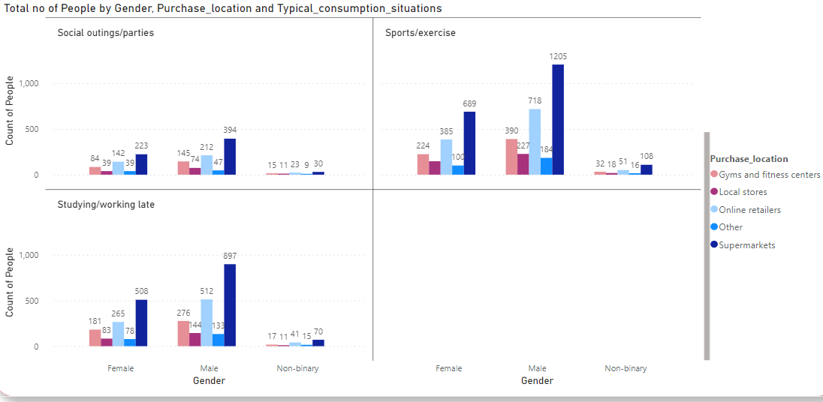
PRIMARY INSIGHTS BASED ON SURVEY RESPONSES
LOCATIONS WHERE RESPONDENTS PREFER TO PURCHASE ENERGY DRINKS
Our Customers mostly purchase in Supermarkets , next to it Online retailers and the third is Gyms and fitness centres.
TYPICAL CONSUMPTION SITUATIONS FOR ENERGY DRINKS AMONG RESPONDENTS
Overall Analysis on situations why people purchase our energy drink
Sports/exercise
Studying/Working late
Social Outings/parties

Slide 13
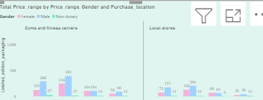

PRIMARY INSIGHTS BASED ON SURVEY RESPONSES
FACTORS INFLUENCE RESPONDENTS' PURCHASE DECISIONS, SUCH AS PRICE RANGE AND LIMITED EDITION PACKAGING?
PRICE RANGE
Customers mainly prefer to purchase our energy drinks in the range of 50-99 mostly and next pace is occupied by 100-150,and next is above 150 and below 50
Hence we need to provide our energy drinks at arrange of 50-99,100-150 mostly such that our business can invade and above 150 price range it is not working well.
LIMITED EDITION PACKAGING
When there is limited edition Supermarkets, Online retailers, Gyms/exercise are ready to purchase at the same time the amount of yes is gust a small greater than no .
Similarly with regard to not sure reply of limited edition packing is less tha tat of yes/no but mostly it follows the order as follows of above

Slide 14
PRIMARY INSIGHTS BASED ON SURVEY RESPONSES
AREA OF BUSINESS SHOULD WE FOCUS MORE ON OUR PRODUCT DEVELOPMENT? (BRANDING/TASTE/AVAILABILITY)
Brand and availability of our codex energy drinks are awesome and compared to other brands our codex brand is available better than the current leading top brands.
Coming to taste/Flavour Preference it is at third place we need to improve it so as to attract as many customers possibly to expand our business
Hence overall we need to improve every thing to reach the top most place.

Slide 15
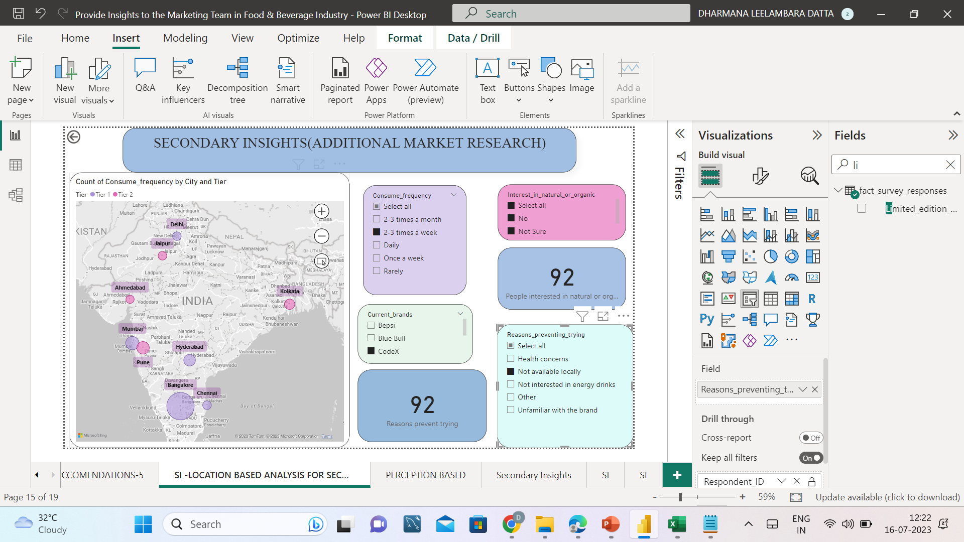
SECONDARY INSIGHTS BASED ON ADDITIONAL MARKET RESEARCH
CONSUME FREQUENCY BASED ON CITIES AND REASONS PREVENT TRYING CODEX ENERGY DRINKS
Consume frequency is maximum at 2-3 times a week
Based On this Criteria Bangalore occupies first place ,second Mumbai, Third Hyderabad
Not available locally is the main reason that prevent from consuming the codex drink later, Not interested in energy drinks, Health concerns
INTERST TOWARDS NATURAL OR ORGANIC CONTENT
With regard to codex brand 506 people are interested towards organic or natural content in the energy drinks that that too from Bangalore occupies first place ,second Mumbai, Third Hyderabad.
Not interested 273
Not sure 201
Hence we can launch products related to organic and natural content for those who are interested in the regions mentioned above.

Slide 16
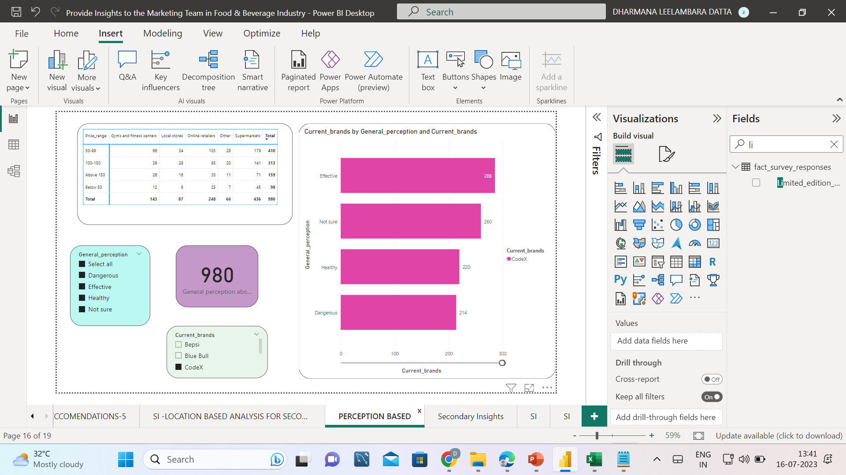
SECONDARY INSIGHTS BASED ON ADDITIONAL MARKET RESEARCH
GENERAL PERCEPTION ON CODEX BRAND
Majority of the customers had voted for codex as it is effective, next some of them are not sure about codex is the next major content and healthy is just greater than dangerous but nearly same based on the responses
PRICE RANGE VS PURCHASE AREA
Overall Purchase based on price range and location has been demonstrated to indicate the total from which location the amount of consumption is more.

Slide 17
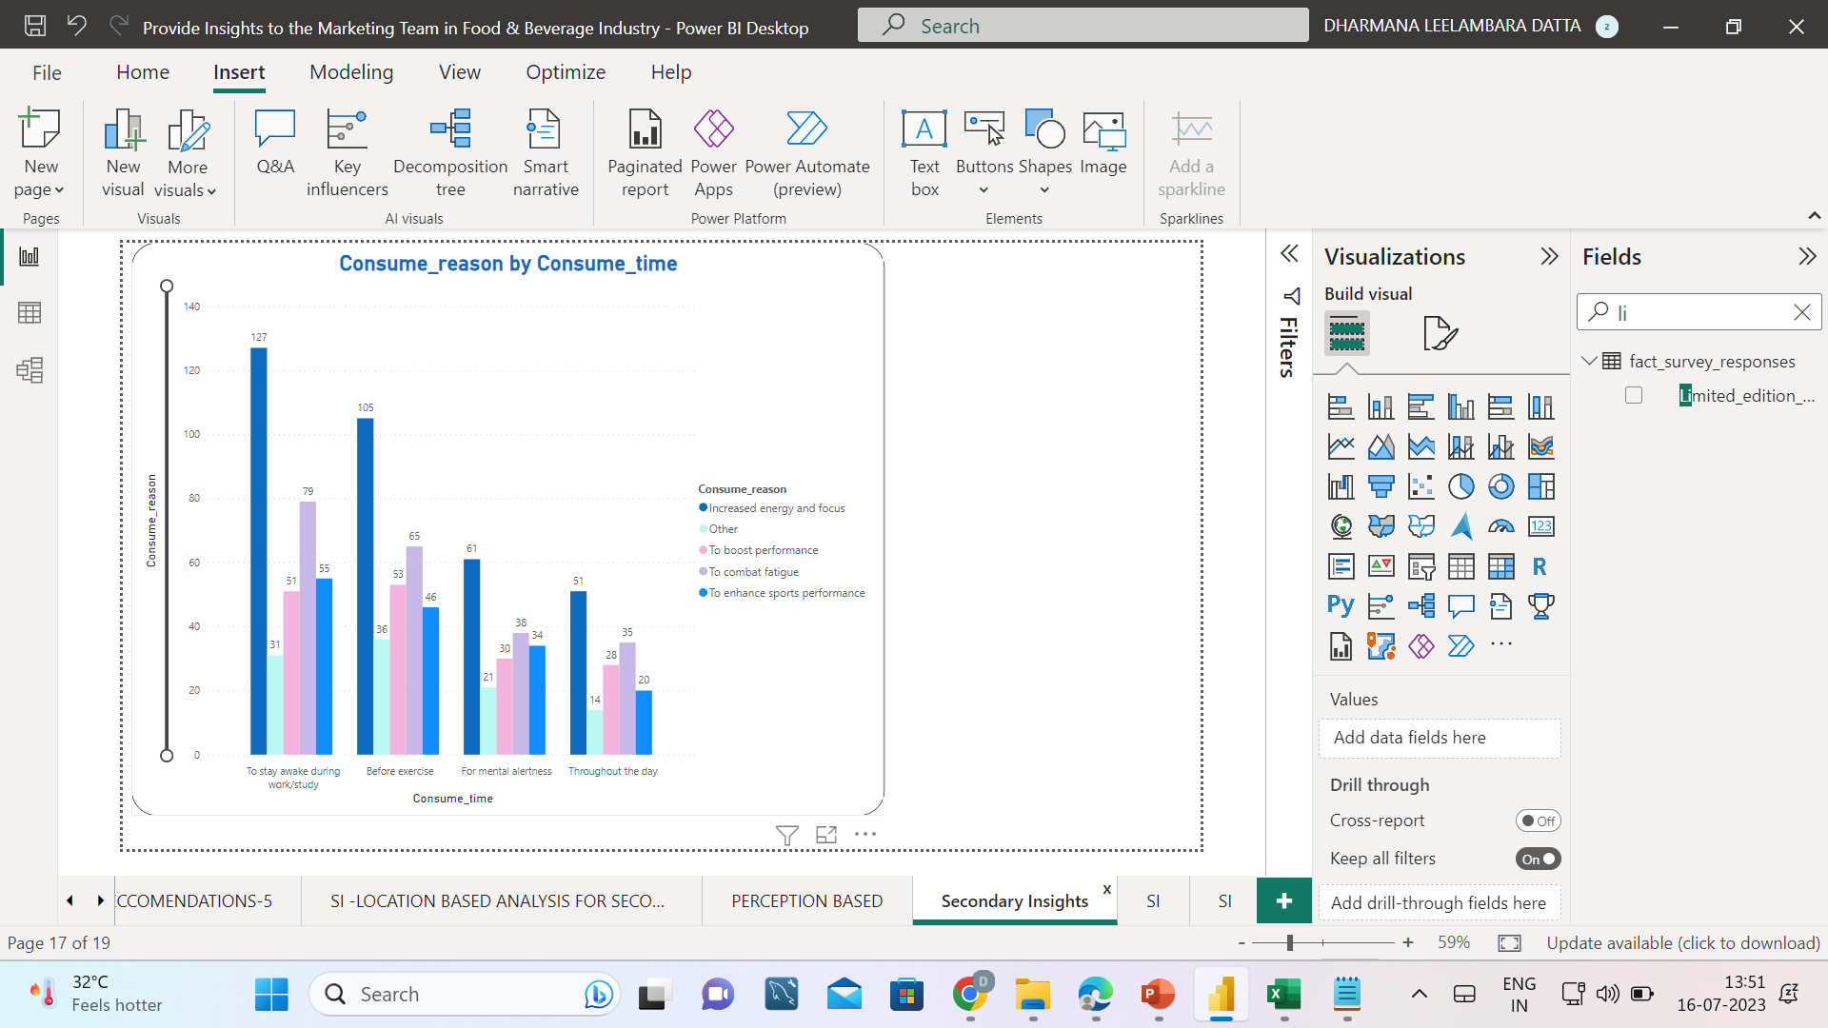
SECONDARY INSIGHTS BASED ON ADDITIONAL MARKET RESEARCH
CONSUME REASON BY CONSUME TIME
Working Professionals consume to stay awake to study and the majority have a reason To increase focus and energy ,Next to combat fatigue, to enhance sports performance, to boost performance.
For Sports/Exercise people consume before exercise and the majority have a reason To increase focus and energy ,Next to combat fatigue, boost performance, at last to enhance sports performance.
Overall for every reason To increase focus and energy ,Next to combat fatigue are same.

Slide 18
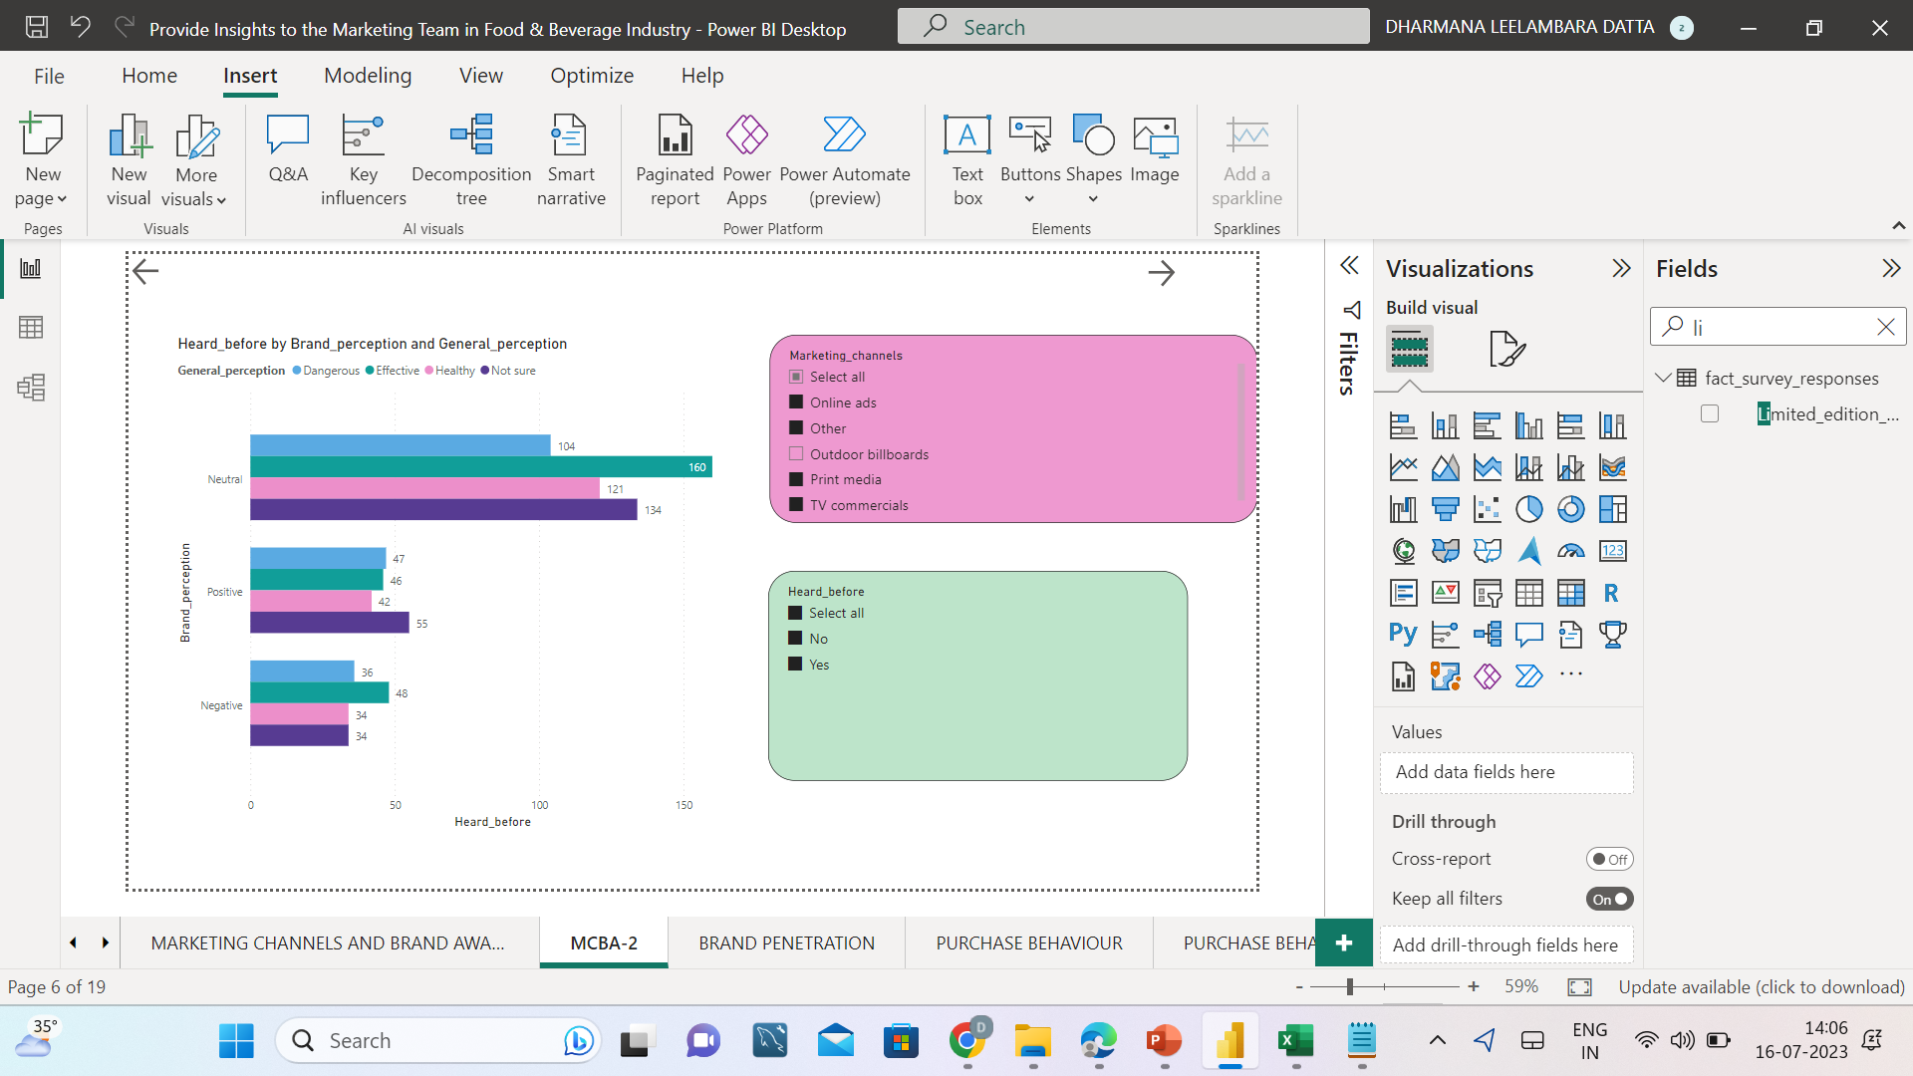
SECONDARY INSIGHTS BASED ON ADDITIONAL MARKET RESEARCH
BRAND PERCEPTION BASED ON THEIR PREFERENCE ON HEARING AND GENERAL PERCEPTION
Majority of the area is shown in neutral content and is shown as effective , later not sure, healthy at last dangerous.
Who are positive are not sure in general perception and dangerous is just more than effective in 1 unit at last healthy.
Who are negative about brand have a general perception of being effective firstly and dangerous at next,haealty and not sure at equal proportions

Slide 19
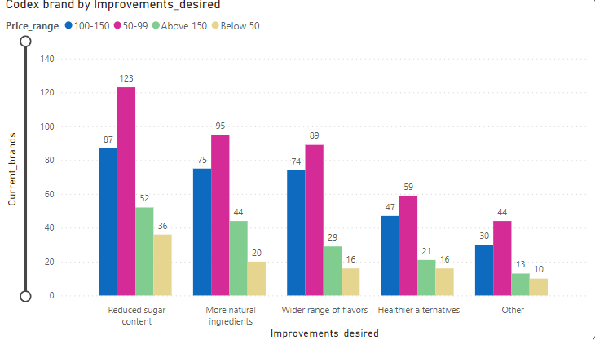
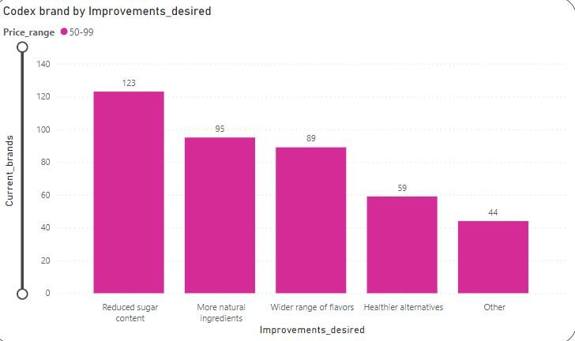
RECOMMENDATIONS
IMMEDIATE IMPROVEMENTS THAT CAN WE BRING TO THE PRODUCT
Improvements that can be made are as follows based on priority
Reduced sugar content
More natural ingredients
Wider range of flavours
Healthier alternatives
Others
IDEAL PRICE OF OUR PRODUCT
Ideal price of the product is 50-99
Since there is a large scope for the purchase of our energy drinks at higher rate available to all type of customers .

Slide 20
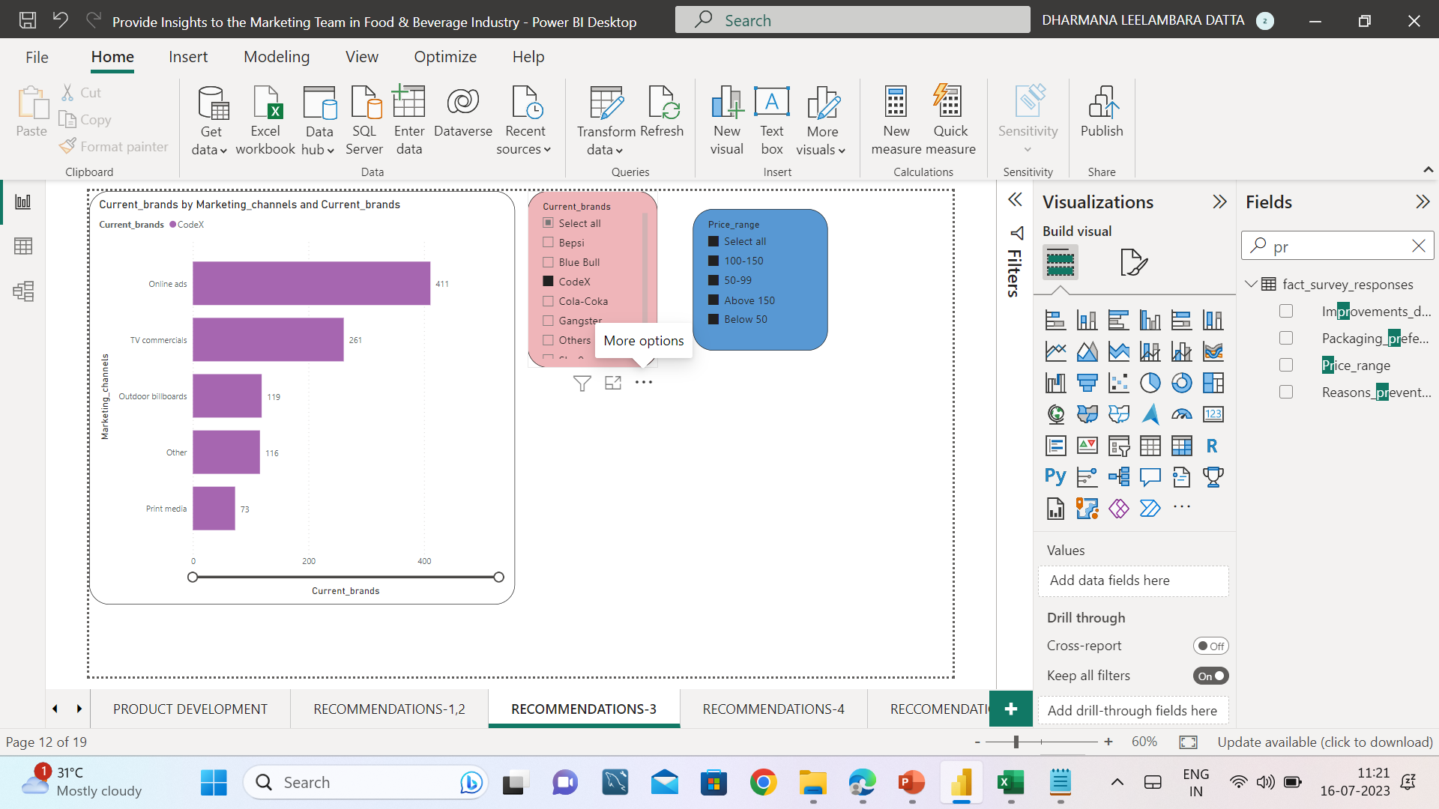
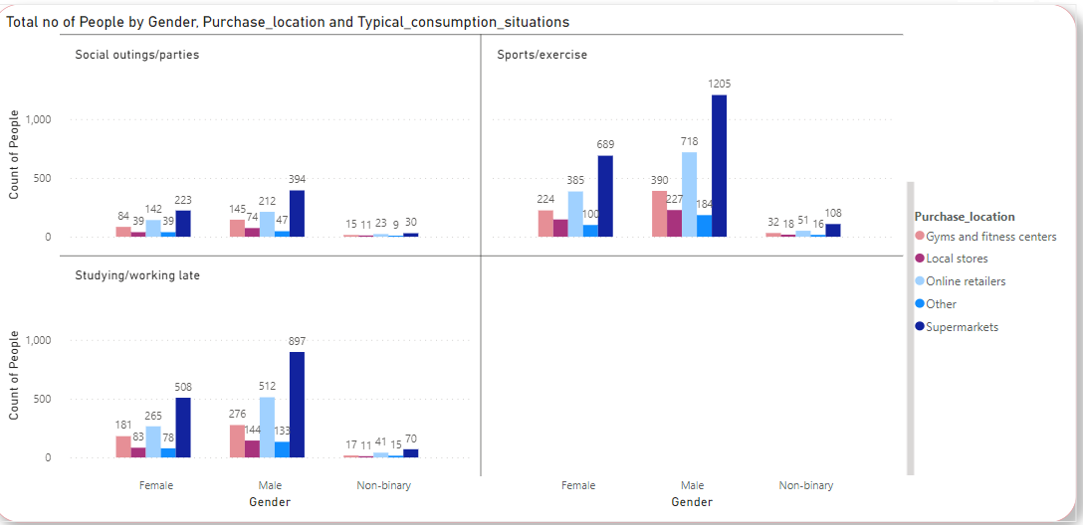
RECOMMENDATIONS
MARKETING CAMPAIGNS, OFFERS, AND DISCOUNTS WE CAN RUN
It is highly preferable to use the top top 2 marketing channels for promotion of our brands
OFFERS AND SISCOUNTS ARE AS FOLLOWS
Since majority of the consumers are from Sports /Exercise ,next Studying/working late,
Social outings /parties we can use these ideas for promoting our business invasion in India
Sports Team Sponsorship
Student Discount Programs
Bundle Deals
Referral Programs
Event Sponsorship and Sampling
Limited Edition Collaborations
Social Media Contests and Challenges
Loyalty Programs
Educational Workshops or Seminars
Gamification and Apps

Slide 21
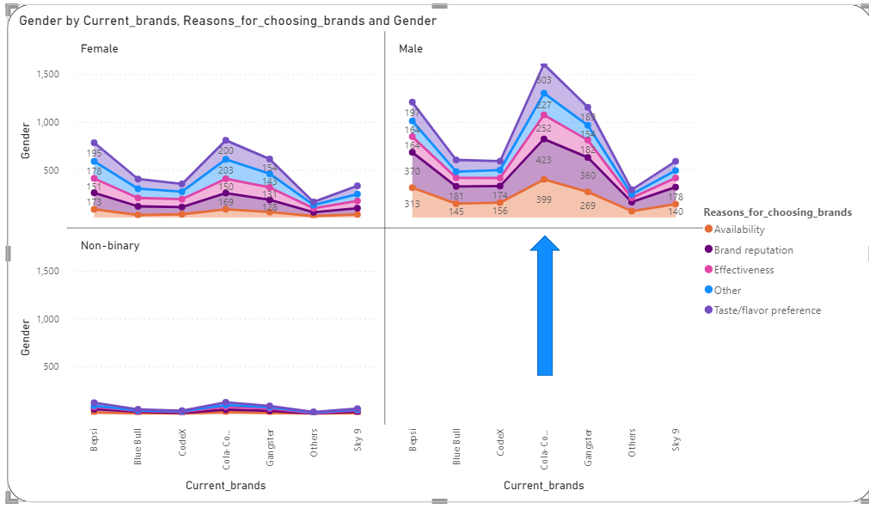
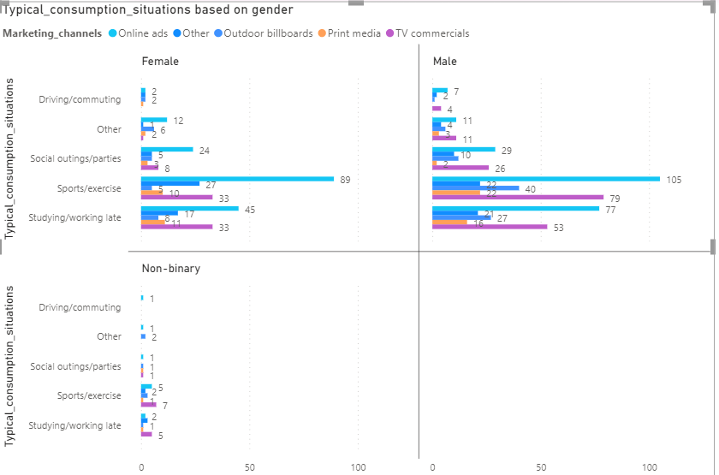
RECOMMENDATIONS
WHO CAN BE A BRAND AMBASSADOR, AND WHY
Cola coka is the brand ambassador since it provides all the necessary needs of the consumers.
We too can reach or beat cola coka by applying the offers and techniques involved in the before slide.
OUR TARGET AUDIENCE
Our target audience are mainly sports/exercise, Studying/working late.
Overall athletes,gym persons, students and working proffesionals are our target audience.

Slide 22
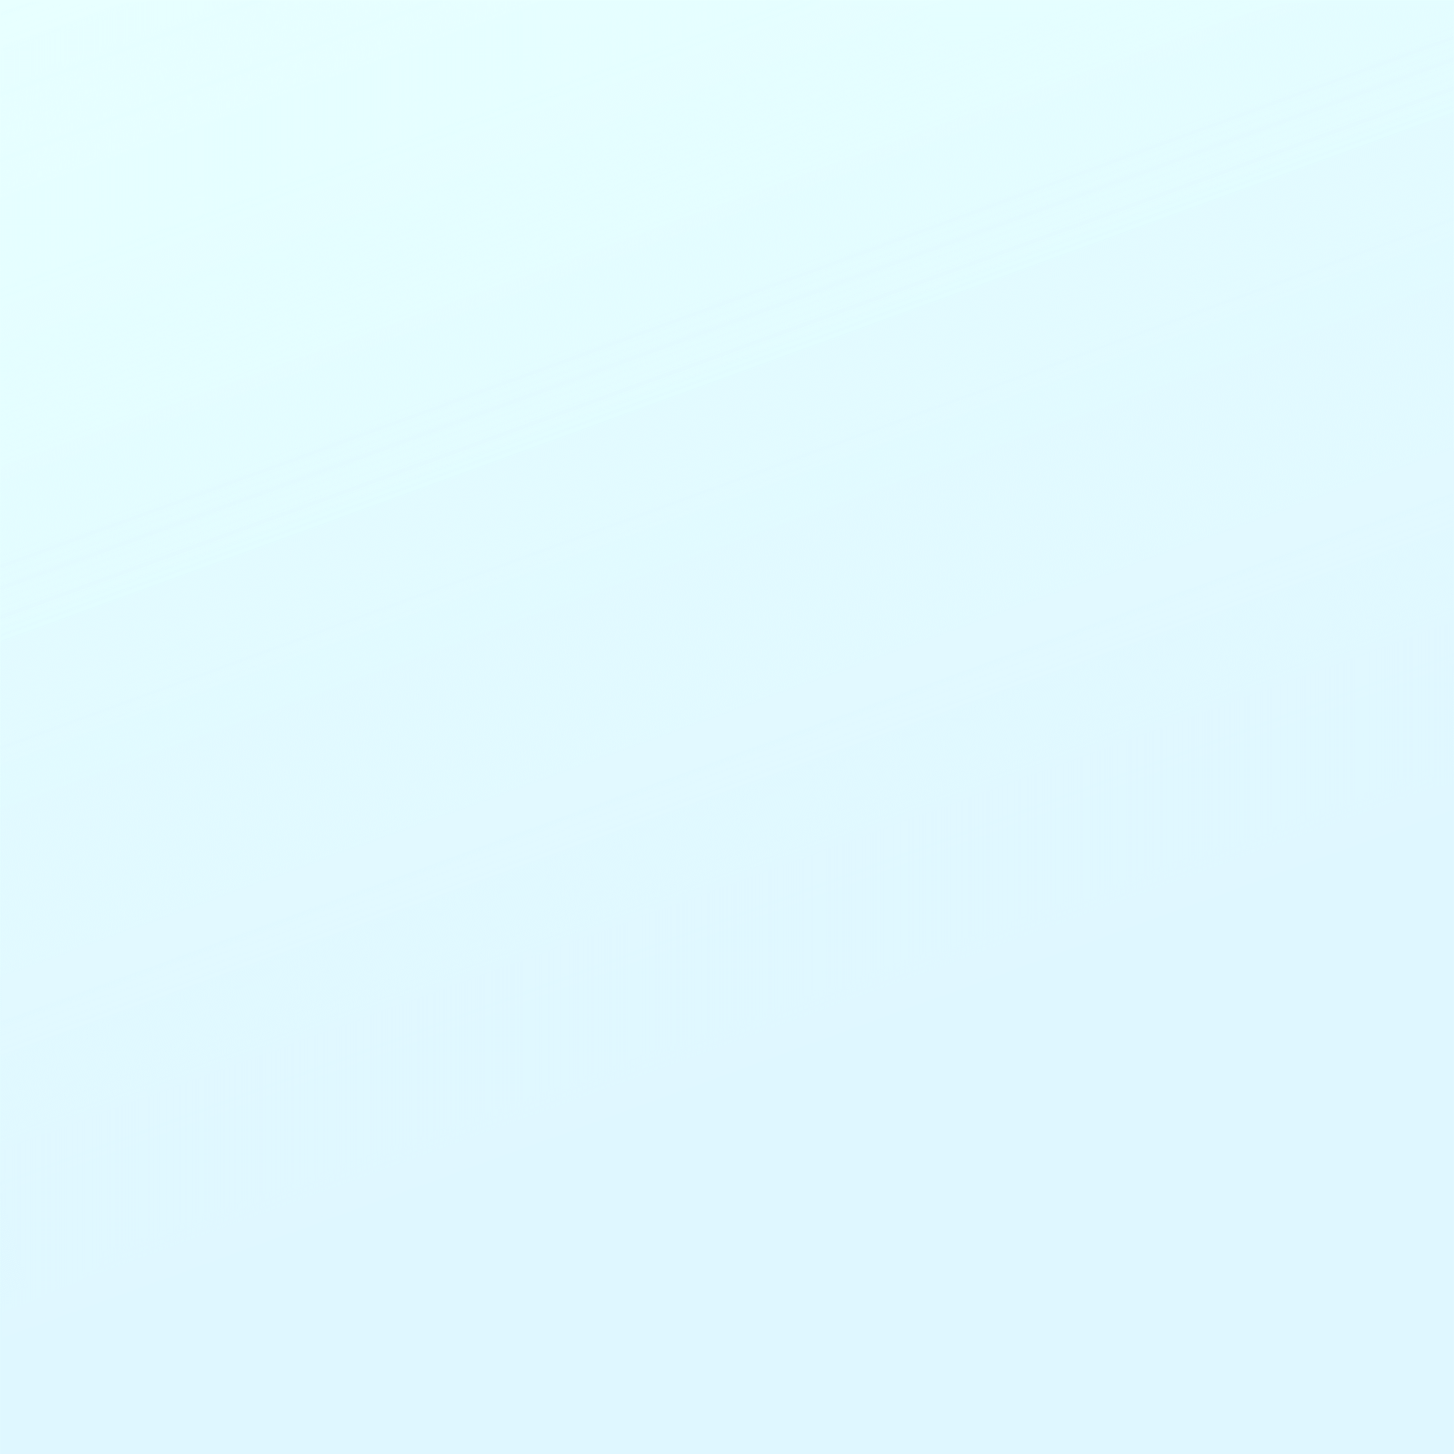

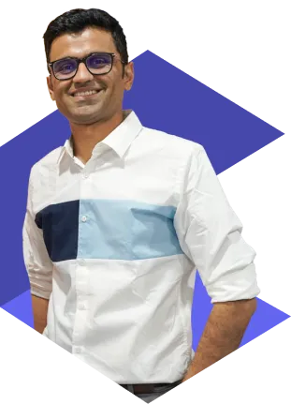
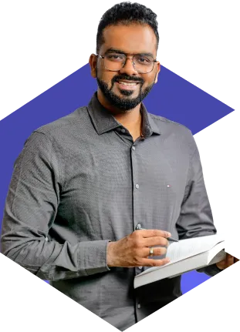
THANK YOU
Hemanand Vadivel
Dhaval Patel

Slide 23

